Slide 1
My MongoDB Journey
By YOURNAME
Notes:
Directions:
Add your name.

Slide 2
Agenda
About me
Why I started using MongoDB
How I learned MongoDB
What I've built with MongoDB
What I’m looking forward to
Lessons learned & pro tips
Notes:
Directions:
We thought this was a good structure but feel free to update it and make it your own.

Slide 3
About Me
I'm a ______ (eg: "software developer")
I regularly work in _______ (languages)
My favorite/go-to programming language is: ______
I've used relational databases for ____ years
My RDBMS experience includes: _______
I joined/started this meet up group in ~__________
Notes:
Directions:
Fill in the blanks or add your own questions.

Slide 4
Why I started using MongoDB
A friend/coworker told me to give it a try
I saw a talk at a meet up/conference
I wanted to learn new tech
My company/team was already using MongoDB
I was inspired by free pizza & swag
Notes:
Directions:
Talk through each point or update the text to your liking.

Slide 5
How I learned MongoDB
I read the documentation (no, really!)
Took a free online course at MongoDB Uni: _____
Inherited an existing project
Hacked on a hobby project
Asked/read a lot of questions on StackExchange
Joined/read the mongodb-user discussion forum
Other: _______________
Notes:
Directions:
Talk through each point or update the text to your liking.

Slide 6
What I've built with MongoDB (so far)
Homework for MongoDB University
A prototype or side project app
A production app
An open source tool or application
Contributions to existing open source
Notes:
Directions:
Add your own bullet points.

Slide 7
What I've built with MongoDB
Screenshot
Notes:
Directions:
Add a screenshot of your project.

Slide 8
What I’m looking forward to
My favorite new feature in MongoDB 3.0: ______
The One Jira I really want to see implemented: ______ (if I could only choose 1!)
Learning more about: _______ (topic)
Using: ______ (upcoming / latest release?)
Notes:
Directions:
Fill in the blanks or update the text to your liking.

Slide 9
Lessons Learned and Pro Tips
Something I wish I knew when I started: _______
Most obvious failed-to-read-the-docs error: _______
Favorite tool(s) for working with MongoDB: _______
Notes:
Directions:
Fill in the blanks.

Slide 10
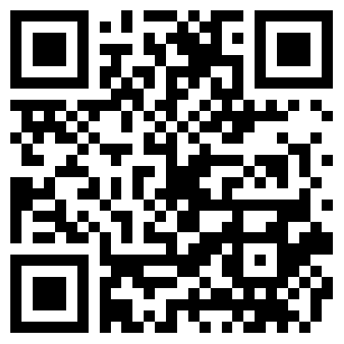
Did you like tonight’s MUG?
Scan this QR Code
Fill out a survey
and let us know.
Notes:
Directions:
Talk through each point or update the text to your liking.

Slide 11



Thanks!
Follow me on:
@YOURNAME
@YOURNAME
/IN/YOURNAME
Notes:
Directions:
Add your social profile names

Slide 12
Updated Free Online Courses
Register today: university.mongodb.com
NEW
M101N: MongoDB for .NET Developers
M101J: MongoDb For Java Developers
M101JS: MongoDB for Node.js Developers
M101P: MongoDB for Developers
M102: MongoDB for DBAs
M202: MongoDB Advanced Deployments and Operations
ADV

Slide 13
Public Training
Register today: university.mongodb.com/training
We regularly host Public Training is the following cities:
New York
Palo Alto
Madrid
London
Any many more cities around the world..
Austin
Rome
Bangalore

Slide 14
Upcoming Certification Exams
Visit: university.mongodb.com/exams
With professional certification, MongoDB recognizes Developers and DBAs with the proficiency to build, deploy and manage applications on MongoDB.
Sign up and take the exam during one of our 2015 exam period:
MongoDB Certified Developer Associate Exam
MongoDB Certified DBA Associate Exam

Slide 15

Save 25% on MongoDB World
Use code: MUGMEMBER2015
Register at MongoDBWorld.com

